Slide 1


Slide 2

GENESIS Shadow Project: Employee Management System
Team Members: Supriya Yadav (99004924)
Palaash Atri (99004930)
Mayank Gupta (99004934)
Shubham Phansekar (99004936)

Slide 3
Project Highlights
Project Name:- Employee Management System
BU Mentor Name:- Sandeep Kumar Merala
GEA Mentor Name:- Thiruppathi Seenivasan
Team member details:-
Intern PS No. | Full Name
99004924 | Supriya Yadav
99004930 | Palaash Atri
99004934 | Mayank Gupta
99004936 | Shubham Phansekar

Slide 4


Agenda
1
Objective & Outcome
2
Introduction
3
Project Plan
4
Progress & Status
5
Implementation
6
Risk and Mitigation
7
Summary

Slide 5
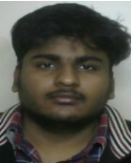

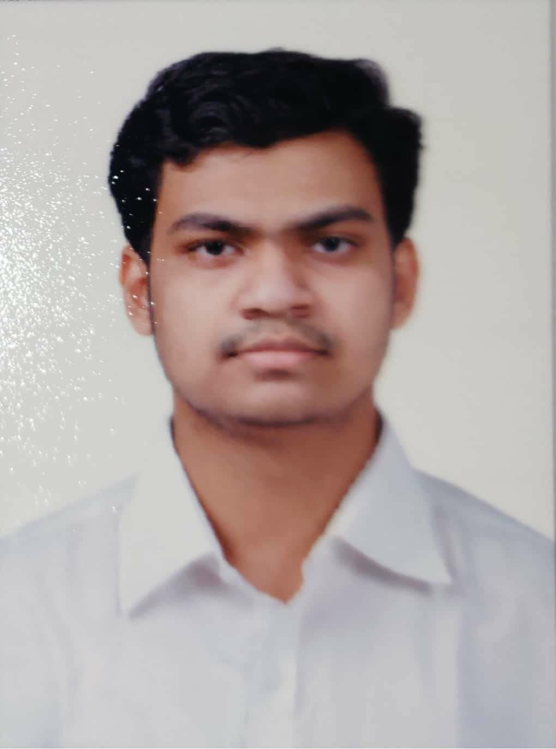
Introduction – Self/Team Members
Project Name : Employee Management System
Team Size : 4
Supriya Yadav
PS: 99004924
DPS JAVA
BTech Computer Engg
SQL, Html, CSS, JS, Java, Kotlin
Palaash Atri
PS: 99004930
DPS JAVA
BTech Computer Engg
SQL, Html, CSS, JS, Java, Kotlin
Mayank Gupta
PS: 99004934
DPS JAVA
BTech Computer Engg
SQL, Html, CSS, JS, Java, Kotlin
Shubham Phansekar
PS: 99004936
DPS JAVA
BTech IT
SQL, Html, CSS, JS, Java, Kotlin

Slide 6
Objective and Outcome
Abstract
Employee Management System is web-based application, having two modules developed, one for like employee management and another for recording employee attendance on daily basis. This web application is build on Spring Framework ,it allows a much easier and less-time consuming approach for employees to mark their attendance . The application supports two level of authentication, where admin role employee create/edit the employee and approve/reject the attendance timesheet and normal user view employee details and enter his daily attendance.

Slide 7
Objectives & Outcomes
Objectives and Learning outcomes:
To Study EMS requirements
Practical exposure to OOP concepts with core java
Practical exposure of Spring Boot framework
Exposure to create and use MySQL database
Understanding of Web Application development with 3 layer of architecture, like UI, Business and persistence layers.
Exposure to Agile development methodology

Slide 8
Objectives & Outcomes
Key Deliverables:
Database Design
Login in/Logout Page
User profile Landing Page
Add/edit User profile image.
User attendance Manipulation page
Error handling methodology
Logging methodology

Slide 9
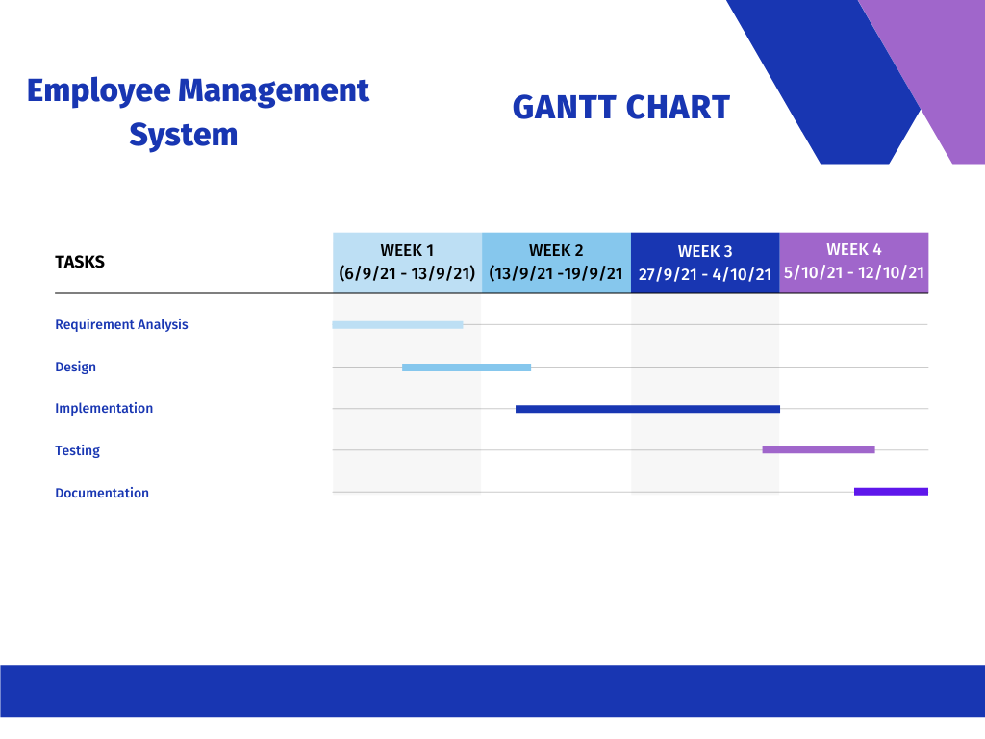
Project Plan

Slide 10
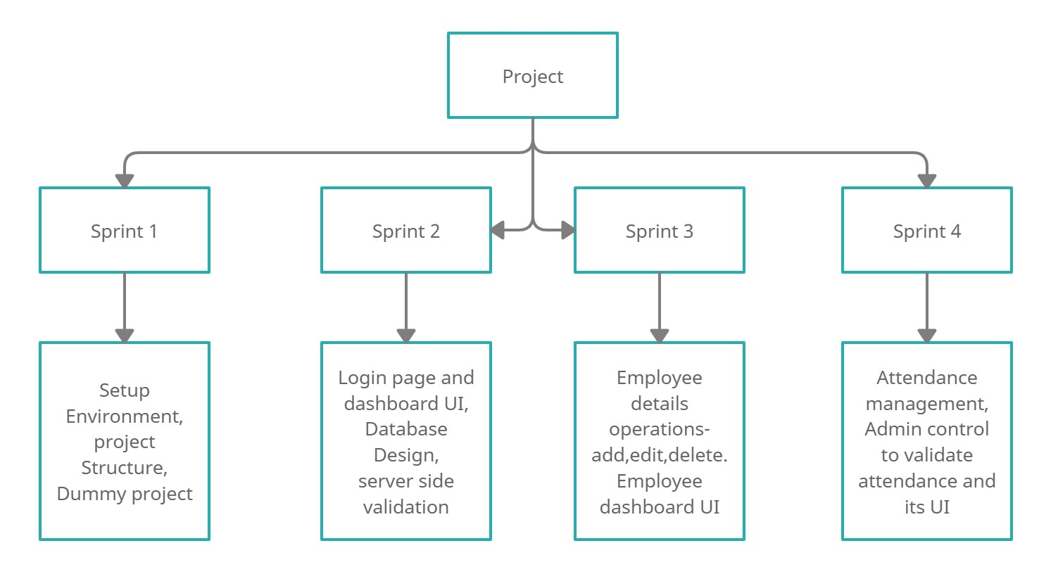
Progress and Status
Work Breakdown Structure:

Slide 11
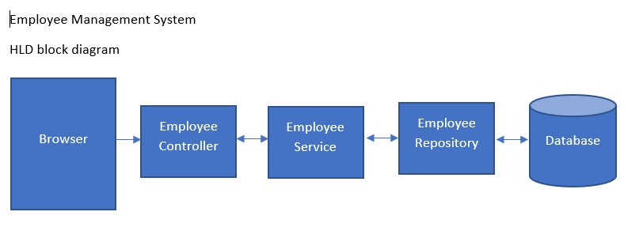
Progress and Status
Progress and Outcomes:
The aim of the project as been reached. The project is implemented based on the problem statement and the business specification given by the business unit.
High level design for EMS application

Slide 12
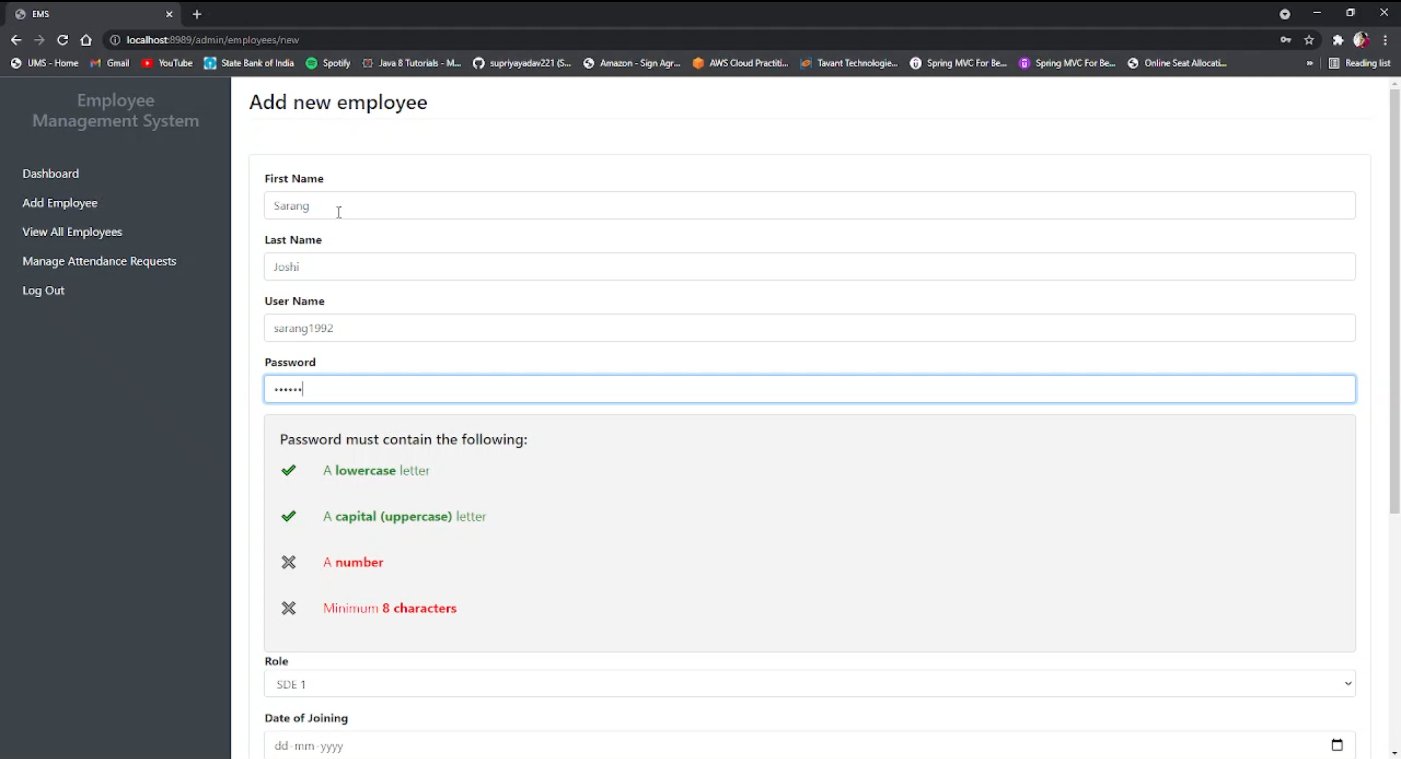
Implementation
Add an Employee
- Admin View (Post)

Slide 13
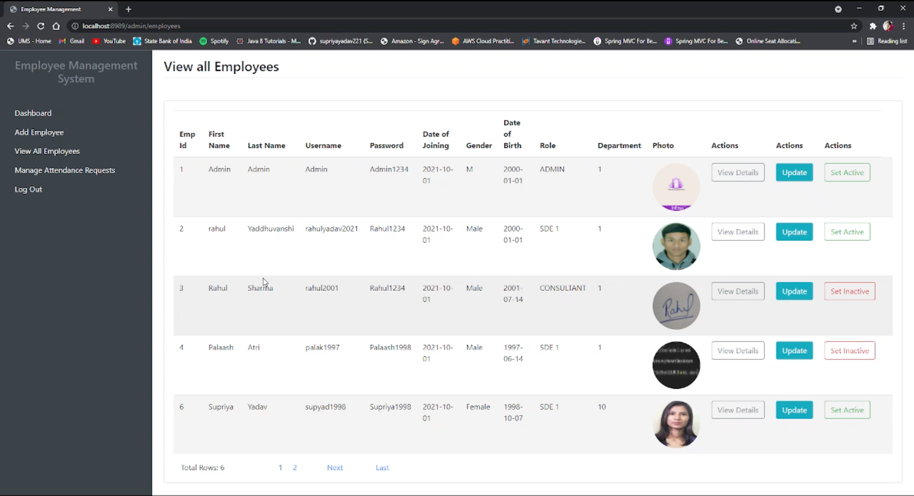
Implementation
View All Employees
-Admin View (Get)

Slide 14
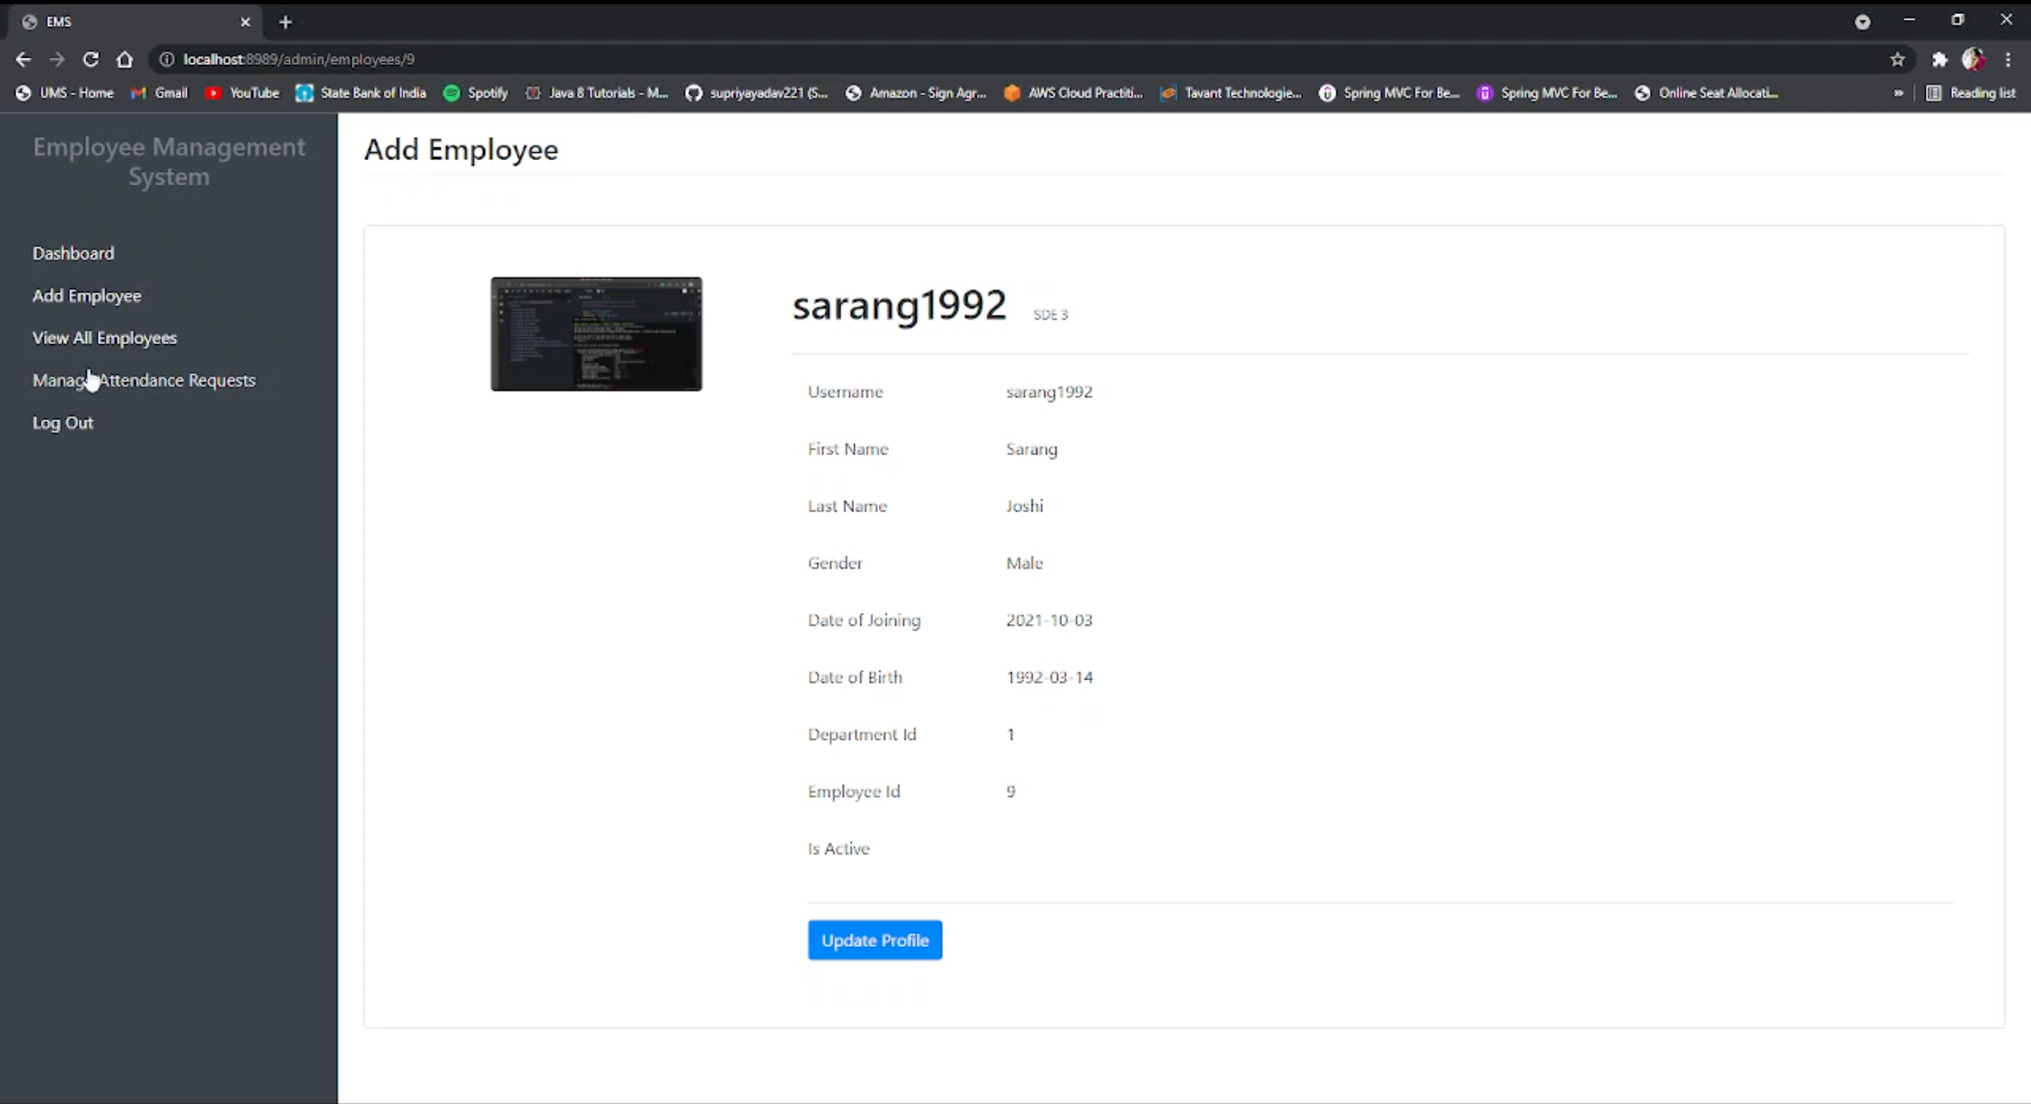
Implementation
View Details
- Employee View (Get)

Slide 15
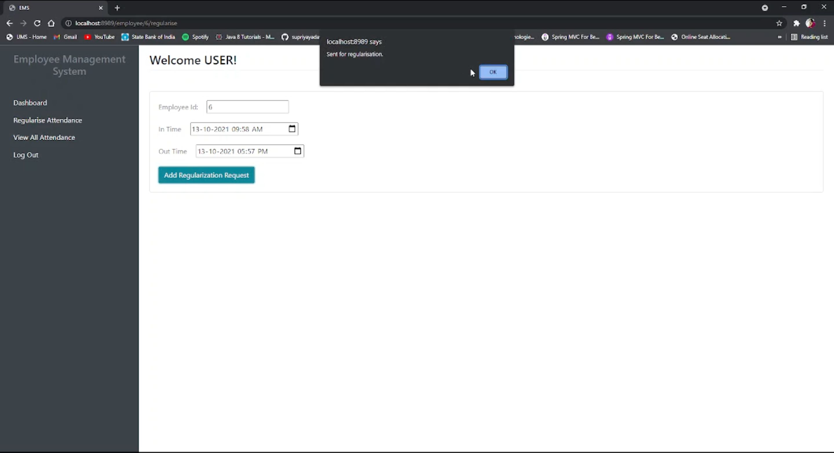
Implementation
Add Attendance
- Employee View (Post)

Slide 16
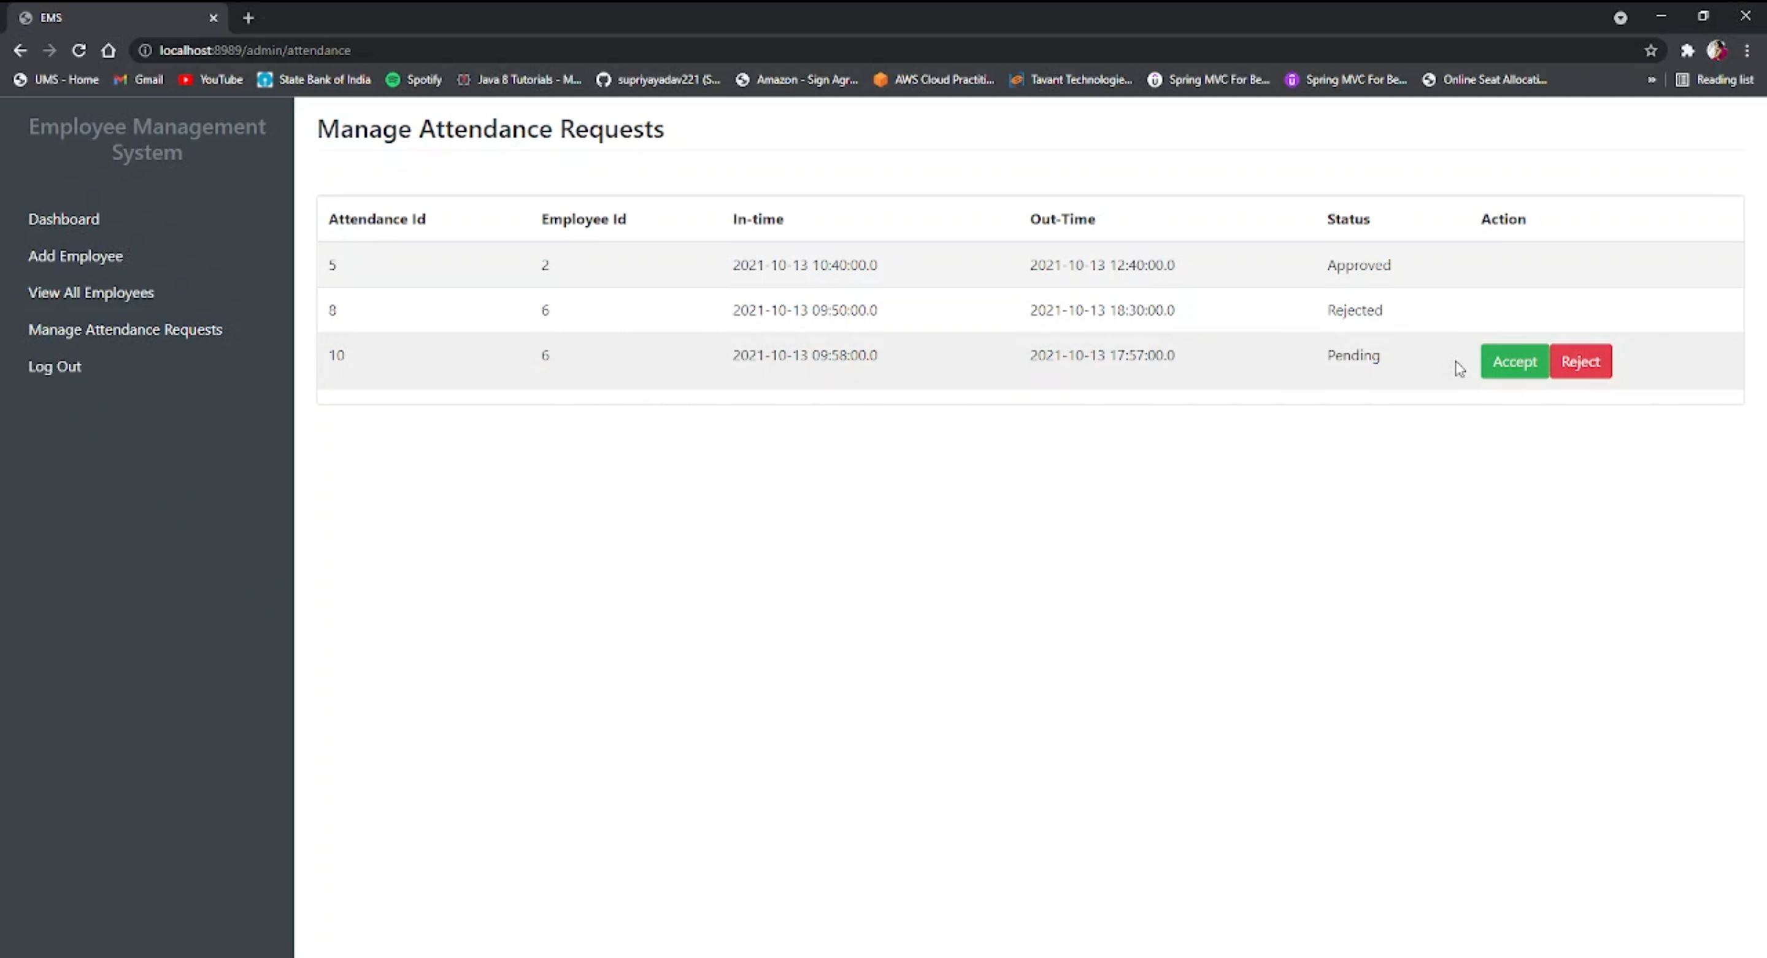
Implementation
View All
Attendance
Requests
-Admin View (Get)

Slide 17
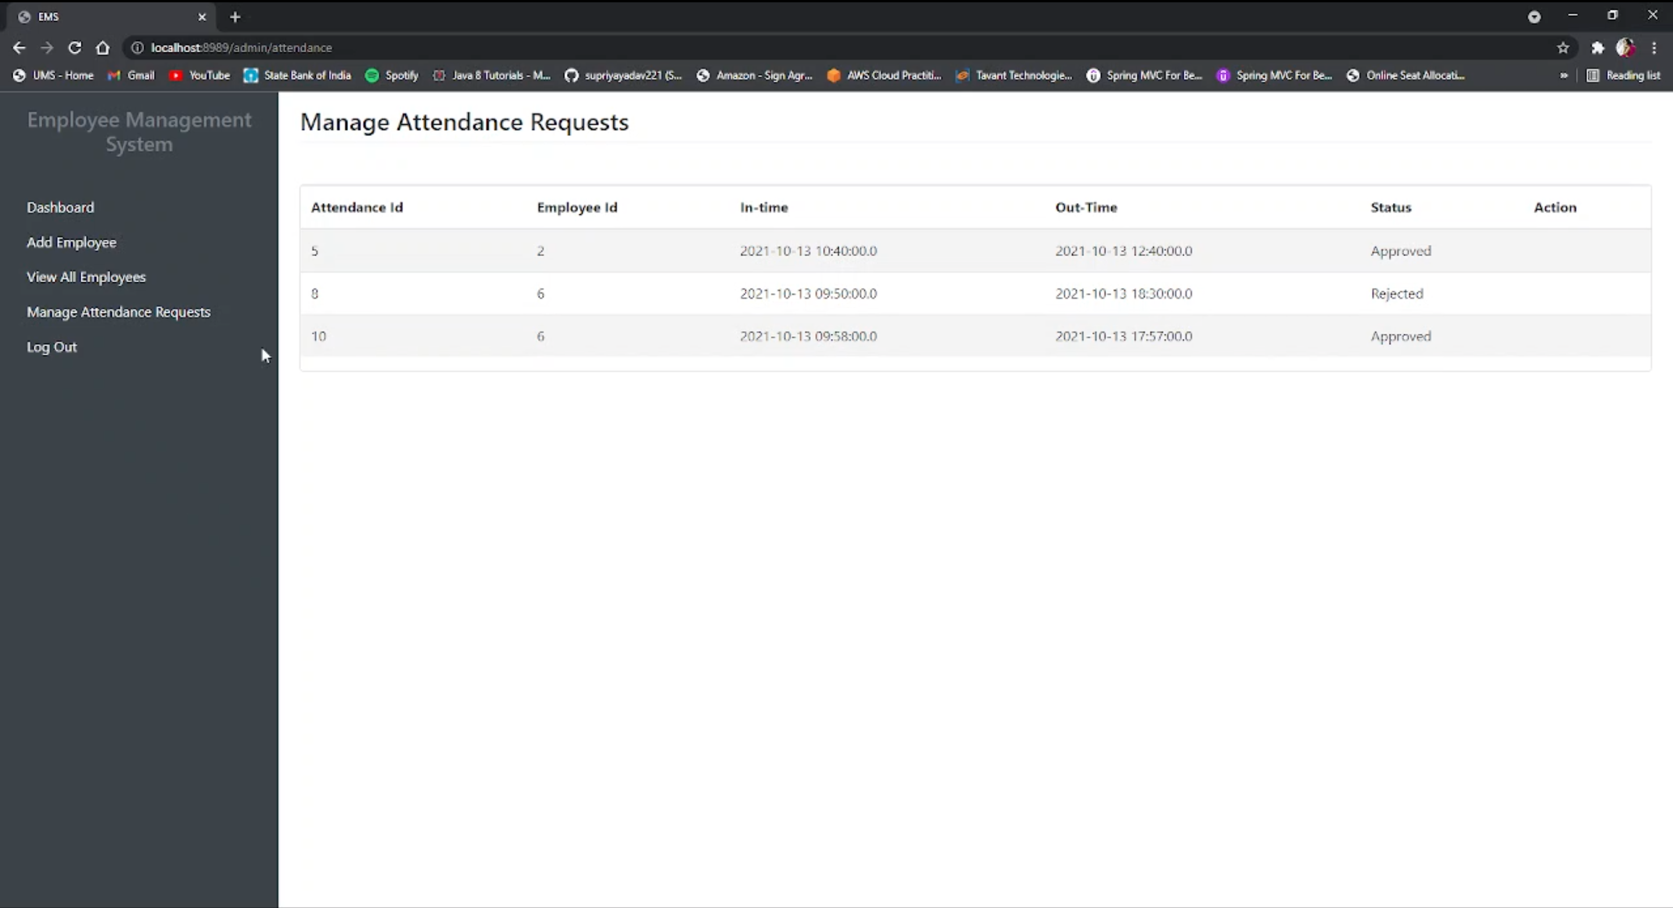
Implementation
Approved
/Rejected
Attendance
Request
-Admin View

Slide 18
Any Potential Risks and Mitigation
Risks
Theft of sensitive information from database, security breach of database.
There is a lot of competitors as similar systems exit in the market.
Difficult to handle huge amount of data in MySql database
Mitigation
We can mitigation to handle large amount of data using other database like Oracle, MS Sql server.

Slide 19
Summary
Employee Management System is a project that allows:
1. An employee and admin to login & logout.
2. An employer to manage details for employee and allows employee to mark his/her attendance.
3. Admin to-do basic CRUD operations on all employees.
4. Employee to only update their own selected fields and request for attendance.
5. Admin to approve or reject the attendance of an employee.

Slide 20

Project Video Snippet

Slide 21


Thank You !

